Slide 1
Autonomous Robot with Arduino Nano V3 for Maze Navigation
ROBOT MAZE Arduino Nnao V3
| Aqualix Slayers | Politehnica University of Timisoara

Slide 2

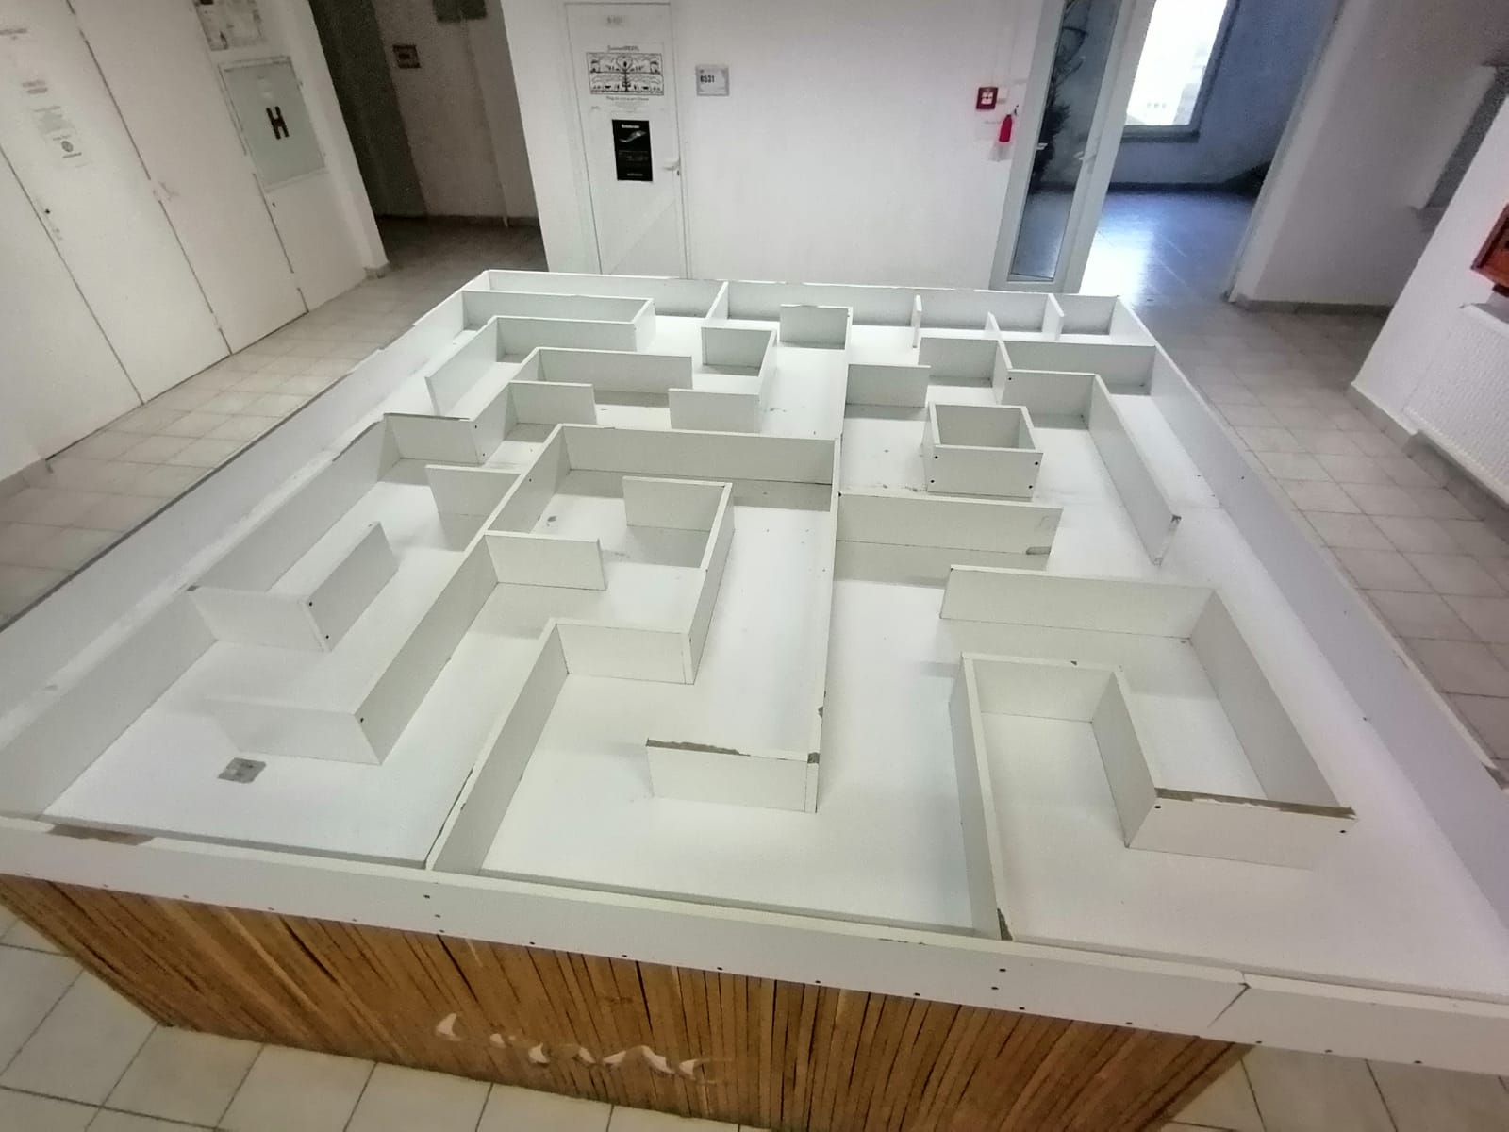
Project Objective
Design and programming of an autonomous robot.
Navigation through a maze without external control.
Using Arduino + sensors + simple decision algorithm.

Slide 3
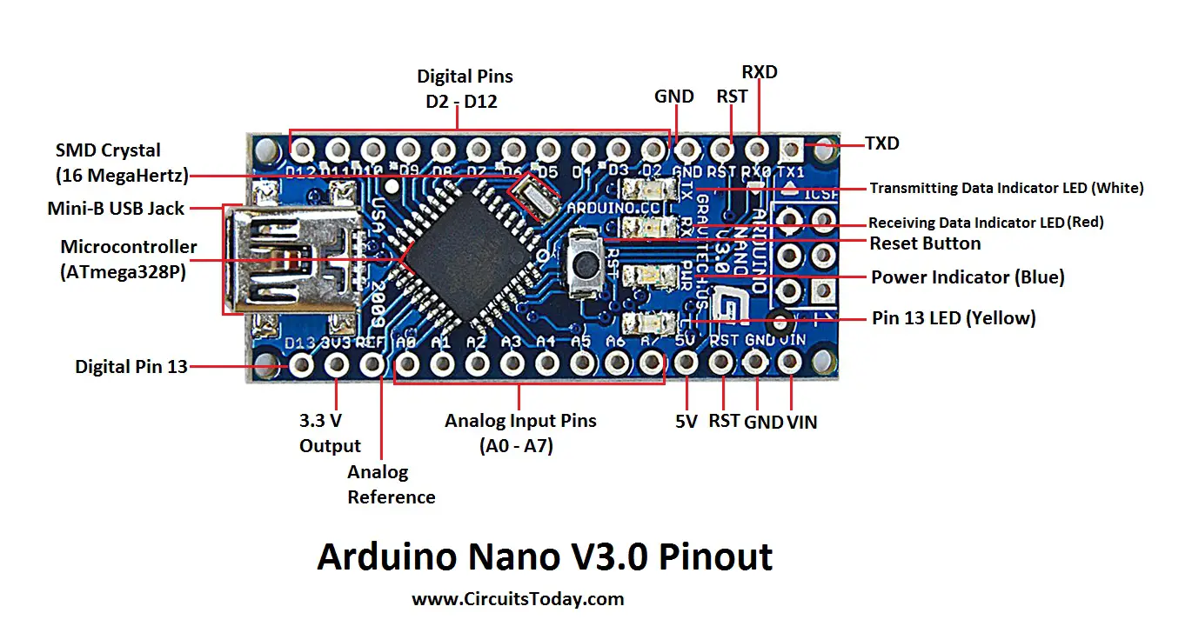
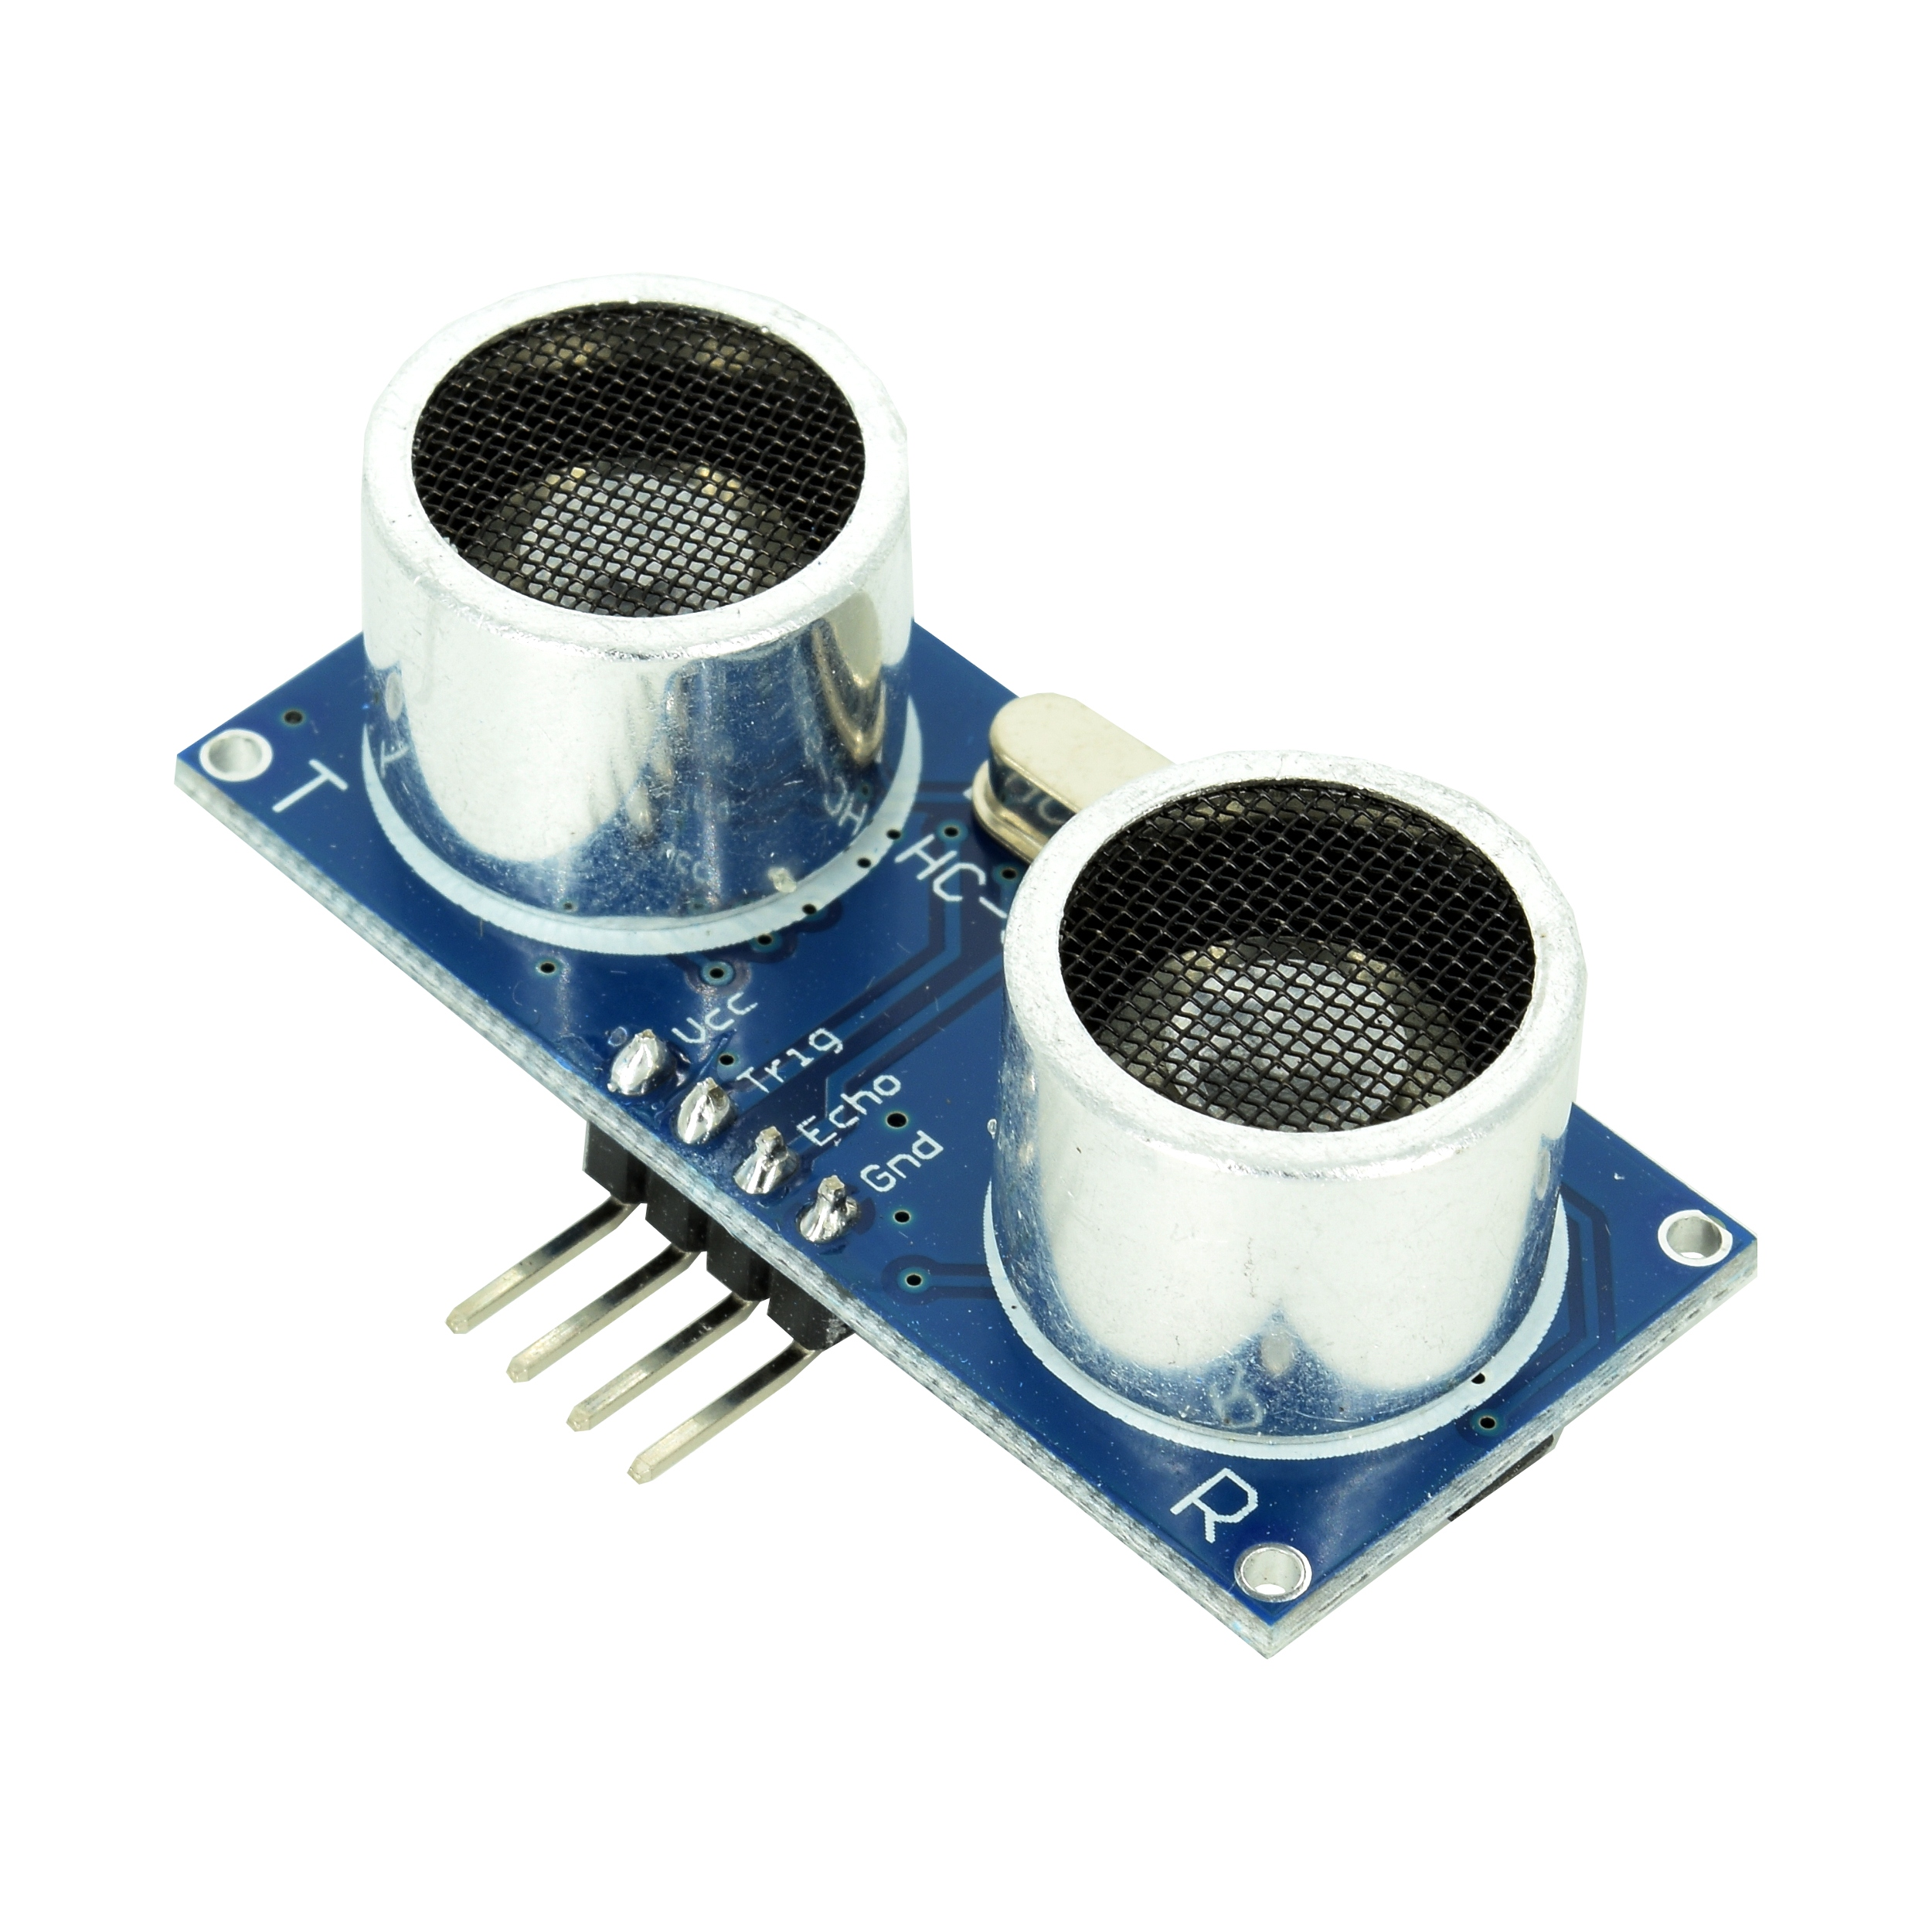
Hardware Components
Arduino Nano V3
DC motors + L298N driver
Robot platform + 9V battery supply
HC-SR04 sensors

Slide 4
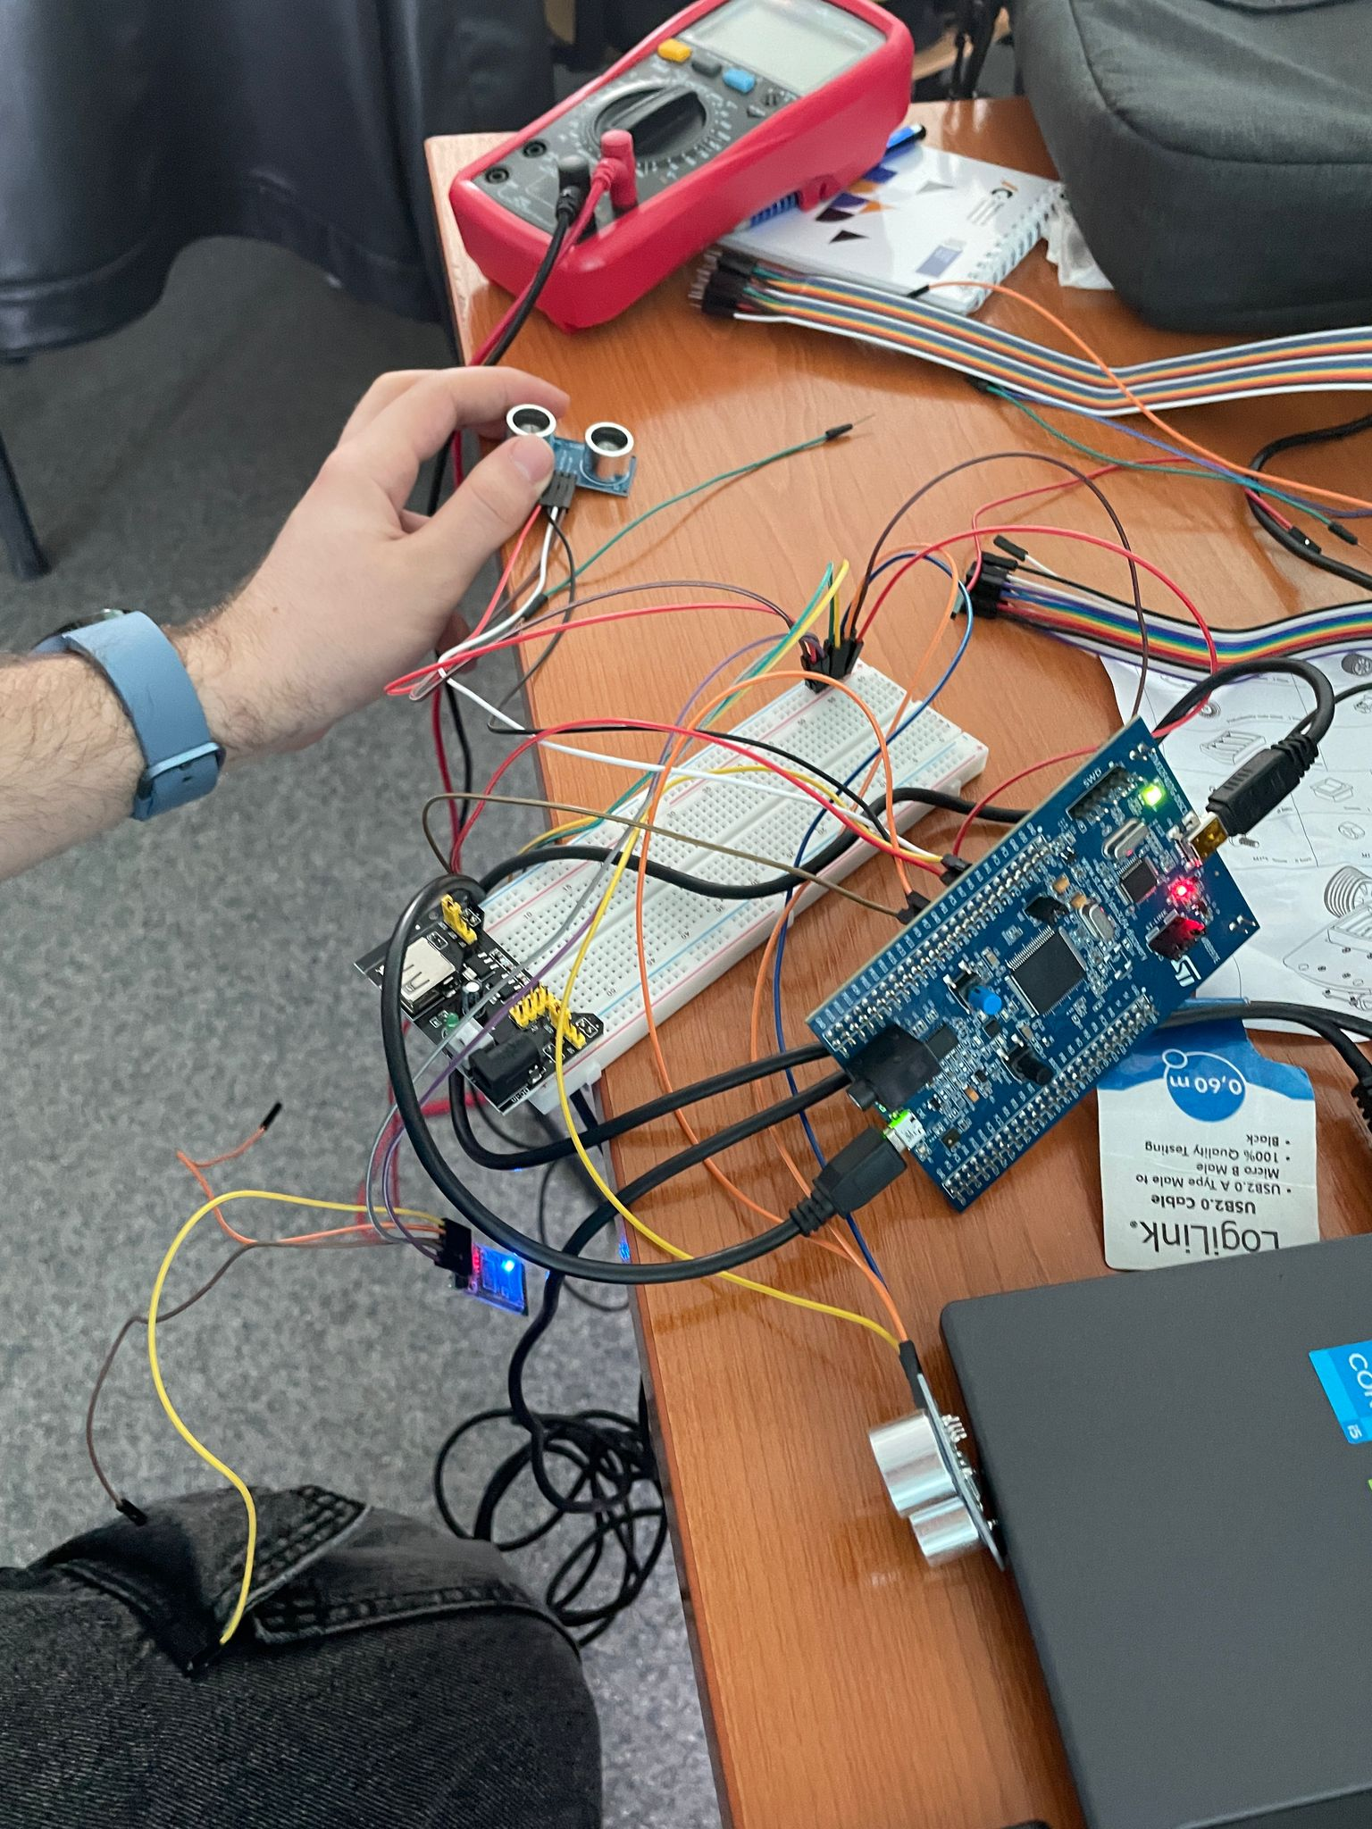
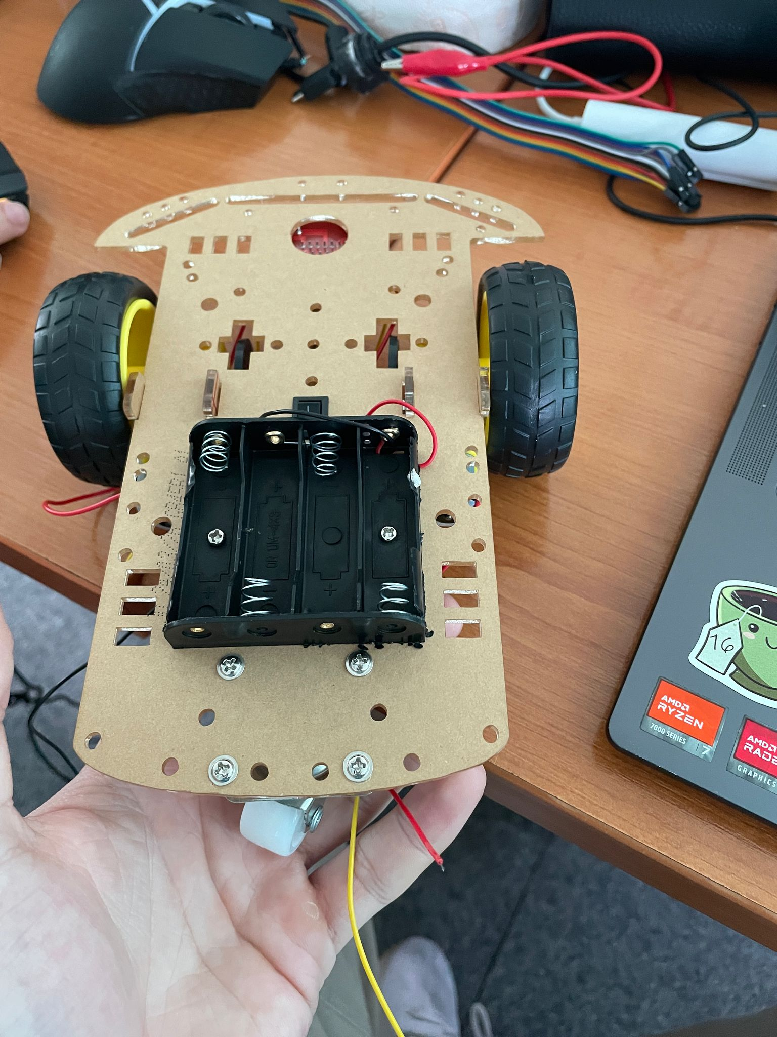
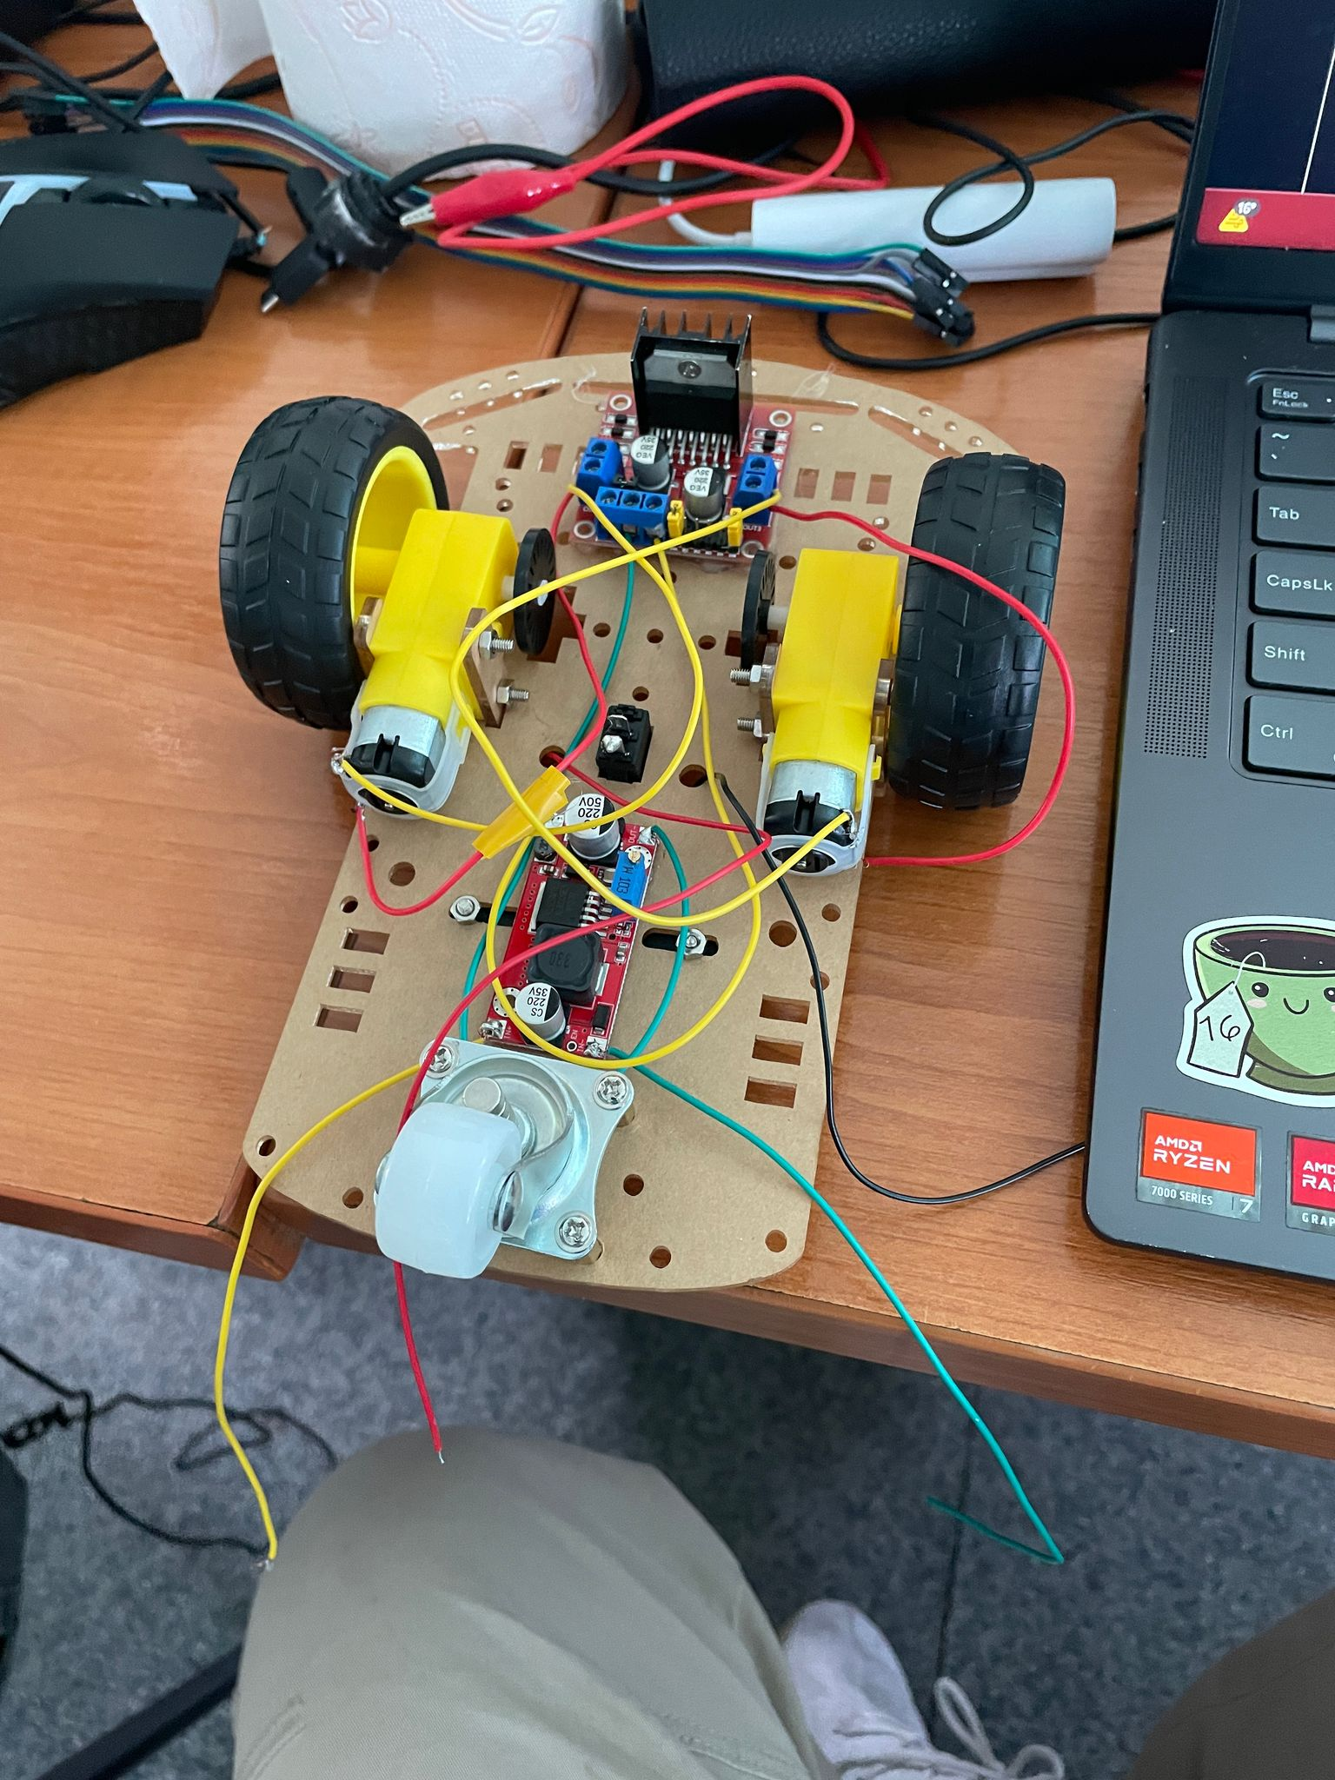
System Architecture
Sensors → Arduino → Motors
Data reading via ADC / GPIO
Motor control using PWM (TIMx)

Slide 5
Navigation Algorithm
Algorithm: wall-following (left-wall tracking)
Decisions based on sensor readings
Obstacle avoidance and maze exit search

Slide 6

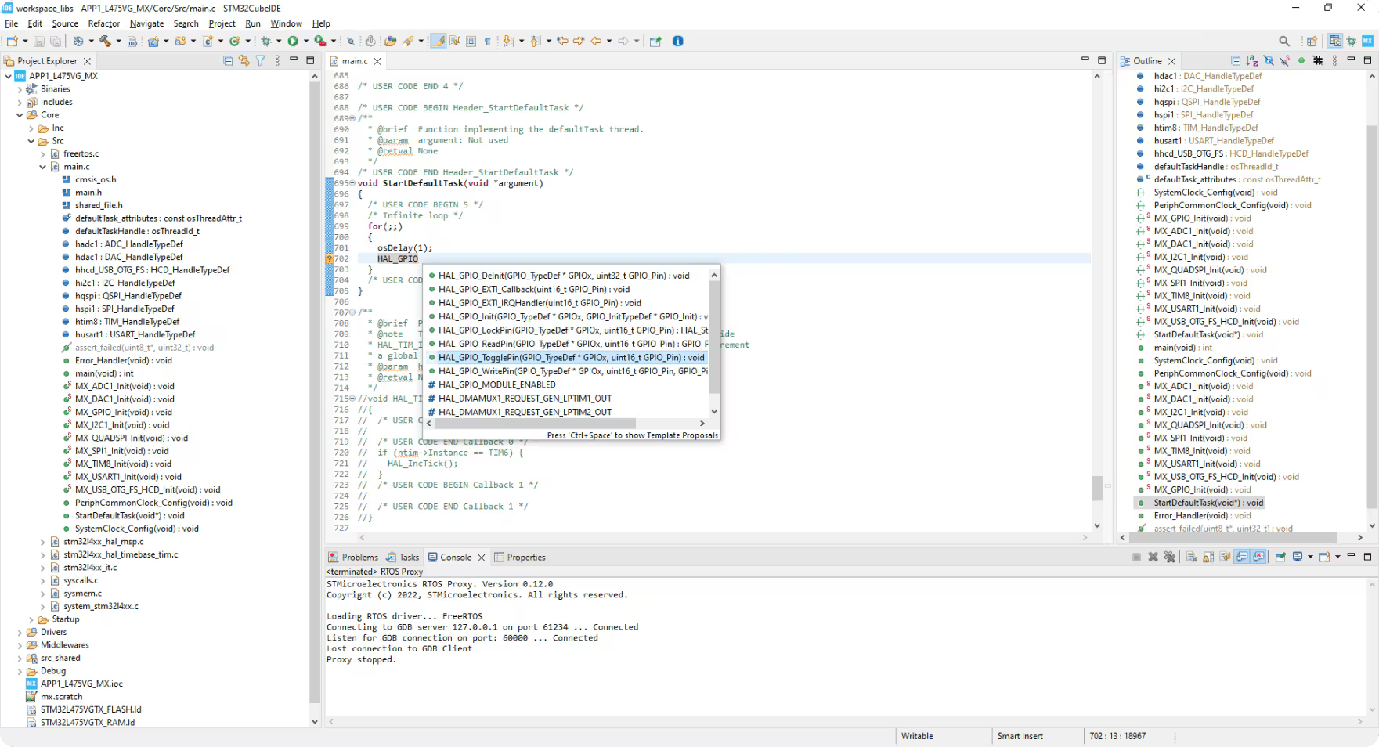
Software
Language: C, using Arduino IDE
Modules: sensors.c, motors.c, navigation.c
Features: PWM, ADC, GPIO, Timers

Slide 7
Conclusion
Arduino robot autonomously navigates a maze.
Complete hardware + software integration.
Solid foundation for more complex projects.

